Slide 2
Endometrial sampling procedures
Dr Vahide Rahmani

Slide 4
INTRODUCTION
office-based endometrial sampling has generally replaced the need for diagnostic dilation and curettage performed in the hospital minimally invasive option for diagnosis of endometrial cancer, hyperplasia, and other endometrial pathology
New techniques may replace direct sampling of the endometrium. These include peripheral blood sampling for circulating tumor cells or cell free DNA. Uterine lavage with molecular testing of the sample is also being investigated .

Slide 5
OVERVIEW
Office sampling versus dilation and curettage
Endometrial sampling offers a number of advantages compared with dilation and curettage:
● Operative setting is an outpatient clinic, rather than an operating room.
● May be performed without anesthesia or with only local anesthesia.
● Minimal or no cervical dilation is required.
The risk of uterine perforation is decreased (office endometrial sampling: 0.1 to 0.2 percent versus dilation and curettage 0.3 to 2.6 percent
● Operating time is brief; actual sampling time is approximately 5 to 15 seconds.
● Less expensive

Slide 6
Sample adequacy and condition
A sample can be obtained in 90 percent or more of patients .It is important to remember, however, that all sampling devices do not provide visualization of the uterine cavity. Thus, they perform better when pathology is global rather than focal (eg, a polyp).
Depending on the details of the abnormal imaging result, a normal office endometrial sampling may require additional operative intervention (eg, dilation and curettage [D&C], hysteroscopy).
Society of Gynecologic Oncology guidelines advise against use of devices that yield crushed (jawed devices), cauterized (hot loops), or very small (jawed devices) samples

Slide 7
INDICATIONS AND CONTRAINDICATIONS Indications
Indications for endometrial sampling include:
● Evaluation of an imaging study (eg, pelvic ultrasound) that shows endometrial pathology prior to an operative intervention.
● Surveillance for endometrial cancer in women who are at high risk of or have a history of endometrial neoplasia.
● Surveillance for endometrial cancer in women at high risk of or with a history of endometrial hyperplasia or cancer managed expectantly or with progestin therapy.
● Assessment for chronic subclinical endometritis as an explanation for adverse pregnancy outcomes .
Some clinicians perform endometrial sampling as part of the evaluation or therapy for infertility, but this is of limited clinical utility.

Slide 8
Women who have undergone uterus-sparing therapy for endometrial cancer should, at the least, have regular endometrial sampling.
Women with Lynch syndrome (hereditary nonpolyposis colon cancer) require surveillance for endometrial cancer
There are no consistent guidelines for screening of women with other risk factors. This must be determined on an individual basis.
Also, in some ethnic or geographic populations .the incidence of endometrial cancer may be increased.
Evaluation for endometrial neoplasia in women with abnormal uterine bleeding or specific cervical cytology results .

Slide 9
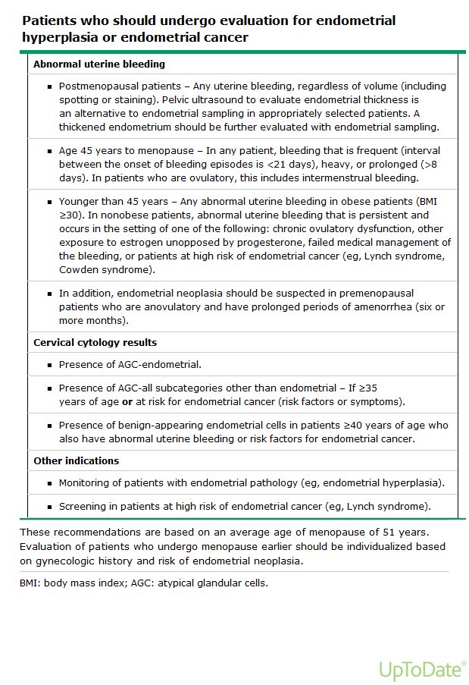

Slide 10
Contraindications
pregnancy
A bleeding diathesis is a relative contraindication since bleeding may be excessive in such patients.
In general, endometrial sampling may be performed in women who are on anticoagulant therapy if coagulation parameters have consistently been within the standard therapeutic range. Laboratory testing should be performed within one month prior to the biopsy. If biopsy is required in a patient with an uncontrolled bleeding diathesis, consultation should be sought from the clinician managing this aspect of the patient’s care. These patients may need to have anticoagulation reversed or have other treatments (eg, desmopressin).
Patients with an uncontrolled bleeding diathesis should undergo endometrial sampling in an operating room setting with access to blood products and anesthesia.

Slide 11
In the presence of acute vaginal, cervical, or pelvic infection, the procedure should be deferred, if possible, until the infection has been treated. This does not apply to clinical situations in which the indication for the biopsy is to evaluate for a subclinical infection.
In rare instances, in which endometrial sampling needs to be performed in a woman with cervical cancer, an obstructing cervical lesion may be a relative contraindication in some patients due to increased risk of bleeding or uterine perforation.
Sampling can be performed with an intrauterine device in place.
In our practice, we have done so without complications. In addition, an ongoing clinical trial reports doing so as part of the study design . No studies have evaluated whether performing endometrial sampling with an intrauterine device in place decreases the diagnostic performance.

Slide 12
PREPROCEDURE PREPARATION Anesthesia
Office sampling procedures can usually be performed without signifficant pain. Discomfort can be minimized by reassuring the woman, explaining each step before doing it, and avoiding use of mechanical cervical dilators and/or a tenaculum, if possible.
Some clinicians recommend an oral nonsteroidal anti-inflammatory drug (NSAID) 30 to 60 minutes prior to the procedure to decrease cramping, and others administer a paracervical block or use an intrauterine instillation of local anesthetic.

Slide 13
Intrauterine instillation of a local anesthetic has been found to be more effective than placebo in randomized trials, although one trial found a significant effect only when the anesthetic was combined with an NSAID (5 mL of intrauterine 2% lidocaine and 550 mg of naproxen sodium) Topical 10% lidocaine spray (4 "puffs") signifficantly reduced pain during the procedure, but there was no difference by 15 minutes afterward . Selective use of these techniques may be useful in some circumstances.

Slide 14
Cervical preparation and dilation
Cervical preparation or dilation is not required in many women, particularly premenopausal parous women. For women in whom it may be difficult to pass the sampling device without cervical dilation, misoprostol (200 to 400 µg) orally, per vagina, or both may be given the night before the procedure .
The vaginal route of administration appears to be more effective than oral.

Slide 15
Women with cervical stenosis not amenable to misoprostol may require that the procedure be performed under general or regional anesthesia, with mechanical cervical dilation or with ultrasound guidance in a surgical suiteProphylactic antibiotics — Prophylactic antibiotics are not necessary during endometrial sampling for the prevention of surgical site infection or bacterial endocarditis.

Slide 16
GENERAL PROCEDURE
The basic steps common to all endometrial sampling procedures are as follows:
● Place the patient in the dorsal lithotomy position. Perform a bimanual examination, paying particular attention to the size, shape, and orientation of the uterus.
● Insert a speculum and visualize the cervix. Cleaning the cervix with antiseptic solution (eg, povidone-iodine) is performed by some, but not all, clinicians.
Sterile preparation in women who are allergic to iodine is discussed separately.

Slide 17
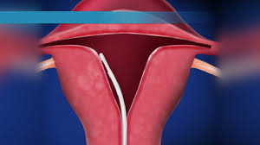
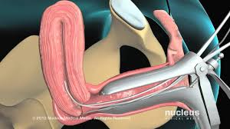

Slide 18
If anesthesia is to be used, it is administered prior to any other manipulation. In many women, an endometrial sampling device can be inserted without grasping the cervix with a tenaculum.
Use of a tenaculum increases patient discomfort.
● A tenaculum should be used if the uterus is not close to axial in position. In such When using a suction device, do not let the sheath come outside of the external os or you will lose the negative pressure. If you do, simply expel the contents of the sheath into the formalin container or onto a sterile nonadhesive bandage (eg, Telfa), taking care not to contaminate the device, and reinsert the sheath. Multiple passes are sometimes needed to assure specimen adequacy.

Slide 19
ENDOMETRIAL SUCTION DEVICES
Suction devices for endometrial sampling consist of a plunger within a sheath. When the sheath is inserted into the uterus, the plunger is retracted, creating negative pressure that draws tissue into the sampling device.
Most suction sampling devices utilize low pressure

Slide 20
However, some devices use a canister or syringe at the proximal end to create cases, place a tenaculum (with teeth in a horizontal position) on the anterior cervical lip and retract outwardly to straighten the cervicouterine angle. Straightening the uterine axis may reduce the risk of uterine perforation. If a tenaculum is required and a paracervical block has not been given, we may apply a local anesthetic (eg, 2% benzocaine gel or 20% benzocaine spray) to the intended site before placing the tenaculum.
Directing the patient to cough while simultaneously applying the tenaculum may also decrease discomfort. Patients scheduled for sampling may be advised to take an NSAID prior to arriving at the clinic.

Slide 22
Using steady and moderate pressure, slowly insert the sampling device through the cervical os and on to the uterine fundus. Stop when resistance is met.
● If the device will not pass through the cervix, attach a tenaculum (if not already in place), and use a series of small (1 to 4 mm) Hegar or similar dilators to gently dilate the canal.
● Many devices are marked with centimeters, so the device can be used to measure the uterine depth. Average uterine length is 6 to 8 cm.
● Stabilize the sheath with one hand and pull the piston out as far as possible to create suction.
● Move the device tip along the endometrial surface using a corkscrew rotation combined with a repeating cephalic-caudal motion while maintaining suction.

Slide 23
● Remove the device when the entire cavity has been sampled. Expel the specimen into a formalin container. If there appears to be insufficient tissue for diagnosis, perform a second pass the device. The same device may be used if it has not been contaminated; it should not have touched the formalin.
Remove the tenaculum, if present. Most bleeding can be controlled with pressure via cotton swabs or a sponge stick. If bleeding persists, use ferric subsulfate solution (Monsel's solution) or silver nitrate sticks to cauterize the site.

Slide 24
When using a suction device, do not let the sheath come outside of the external os or you will lose the negative pressure.
If you do, simply expel the contents of the sheath into the formalin container or onto a sterile nonadhesive bandage (eg, Telfa), taking care not to contaminate the device, and reinsert the sheath. Multiple passes are sometimes needed to assure specimen adequacy.

Slide 25
ENDOMETRIAL SUCTION DEVICES
Suction devices for endometrial sampling consist of a plunger within a sheath. When the sheath is inserted into the uterus, the plunger is retracted, creating negative pressure that draws tissue into the sampling device.
Most suction sampling devices utilize low pressure. However, some devices use a canister or syringe at the proximal end to createhigher pressure, which removes a greater quantity of tissue

Slide 26
Low-pressure devices
— Low-pressure endometrial suction devices (eg, Pipelle, Endocell) are the most popular method for sampling the endometrial lining. They are typically constructed of flexible polypropylene with an outer sheath that is approximately In a typical procedure, 5 to 15 percent of the endometrial surface area is sampled .
Failure to obtain tissue occurs in approximately 0 to 8 percent of low-pressure endometrial suction device procedures .

Slide 27
One approach to improving the tissue adequacy rate is by using a technique that combines a corkscrew twisting motion and uterine curettage. When using this method, the device is inserted to the fundus and then withdrawn to the lower uterine segment, alternating between a corkscrew twisting motion and the motion usually used to curette the endometrium during a dilation and curettage.
Data are limited on the relative efficacy of the combined approach. In a retrospective chart review with uniform pathology evaluation, use of a corkscrew twisting motion and uterine curettage yielded adequate tissue in 95 percent of cases, which was higher than the 77 percent success rate with a corkscrew technique alone.

Slide 28
Higher-pressure devices
Higher-pressure devices (eg, Vabra aspirator, Karman cannula) are used less frequently than low-pressure devices because they are less comfortable for the patient. They are also less flexible, and typically require use of a tenaculum, cervical dilation, and a paracervical block .
An advantage of the Vabra and Karman systems is that they yield a large tissue sample, comparable to dilation and curettage.
These devices are particularly useful in women with moderate bleeding, since, in our experience, they can circumvent the intrauterine clots and reach the endometrial surface more reliably than low-pressure devices

Slide 30
Vabra – The Vabra aspirator is available as a 4 mm disposable plastic or a 2 or 3 mm stainless steel device . Suction is initiated via an external vacuum pump, which can be noisy. The tissue sample is retrieved from a tissue trap and placed in formalin.
● Karman – The Karman cannula comes in diameters of 4 to 6 mm and is made of flexible plastic with two ports at the distal end . Suction is provided by a reusable syringe connected to the disposable cannula. An external vacuum pump can also be used.

Slide 31
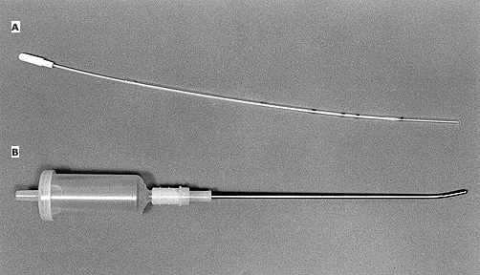

Slide 32
ENDOMETRIAL BRUSH
The endometrial brush (eg, Tao Brush) is a disposable device with a brush at the distal end, similar to the brush commonly used for endocervical sampling. Several observational studies have compared endometrial sampling results from the endometrial brush with those of an endometrial suction sampling device .
In a larger study, 526 pre- and postmenopausal women were evaluated using both the Tao Brush and the Pipelle . In the postmenopausal women, endometrial sampling with the brush resulted in a signifficantly higher proportion of adequate endometrial samples compared with the suction device, whether the techniques were performed with (83 versus 50 percent) or without (61 versus 36 percent) the assistance of hysteroscopy. In premenopausal women, no differences were found between the two techniques in regard to adequacy of sampling

Slide 33
Another approach is to use the brush and suction device sequentially during the same procedure. In one study of 101 women, combined use had a sensitivity and specifficity of 100 percent for diagnosis of endometrial hyperplasia or cancer .

Slide 34
SIDE EFFECTS AND COMPLICATIONS
The most common side effect of endometrial sampling is cramping, which subsides rapidly after the procedure is completed. Cramping tends to be more severe with the higher-pressure suction devices than low-pressure devices because the former is more rigid, the suction is greater, and larger samples are removed. Many women will experience light vaginal bleeding or spotting for several days following the procedure. Vasovagal reactions are not uncommon during endometrial sampling. Such reactions can generally be prevented by allowing the patient to eat and drink before the procedure and by minimizing pain through use of analgesics and, if necessary, local anesthesia. The risk of uterine perforation is approximately 1 to 2 per 1000 procedures

Slide 35
Rare complications include excessive uterine bleeding (especially with undiagnosed coagulopathies), uterine perforation (risk, 0.1 to 1.3 percent), pelvic infection, and bacteremia (including sepsis and endocarditis). Uterine perforation during office endometrial biopsy is rare and is difficult to detect.
Most cases are likely to be asymptomatic, or the patient may have atypical pain during the procedure. Theoretically, leakage of clear peritoneal-type fluid from the vagina may indicate a possible perforation; however, this is a nonspecific finding. If perforation is suspected, additional measures should be taken for evaluation and management. In our practice, if we have a small, but low suspicion of a perforation, we counsel the patient to call with worsening abdominal pain or fever. Uterine perforation is discussed in detail separately

Slide 36
POSTPROCEDURE CARE
The women should remain in a semirecumbent position for several minutes after the procedure to reduce the chance of a vasovagal episode. She may then leave the office if she is not light-headed and there is no heavy bleeding.
Cramping can be managed with nonsteroidal anti-inflammatory drugs, although persistent cramping is unusual. The patient should call to report any fever, cramping continuing for 48 hours or more, increasing pain, foul-smelling vaginal discharge, or bleeding heavier than a normal period. She may resume her usual activities, including coitus, as soon as she is ready.

Slide 37
SUMMARY AND RECOMMENDATIONS
Office endometrial sampling procedures have largely replaced dilation and curettage for diagnosis of endometrial neoplasia. The indications for endometrial sampling include abnormal uterine bleeding or surveillance for endometrial cancer in women who are at high risk (eg, have a history of endometrial neoplasia). ● The major contraindication to endometrial sampling is pregnancy, whereas acute cervical or uterine infection and bleeding diathesis are relative contraindications.
An endometrial sample can be obtained in 90 percent or more of patients. All endometrial sampling devices may perform better when pathology is global rather than focal.

Slide 38
● Endometrial sampling using a disposable low-pressure suction device is a popular technique because discomfort is minimal. Higher-pressure devices are useful when a larger sample is desired.
● For postmenopausal women, observational data suggest that endometrial sampling with a brush is more likely to yield an adequate sample than sampling with lowpressure suction device. Combined use of these two devices increased the diagnostic performance.
● The most common procedural side e!ects are cramping and vasovagal reactions; uterine perforation is the most serious potential complication.

Slide 39
Thanks For Your Attention

